Slide 1

FRIENDER
TWITTER USER RECOMMENDATION
GROUP 2
AKANGSHA | ANGAD | CHUAN JIE | SHUN JIE | YUHUI

Slide 2

BACKGROUND
330 million active monthly users as of Q4 2017
Tweets shared publicly
Can follow celebrities, companies, family, friends
Can favorite and retweet posts
Recommended list of users to follow

Slide 3
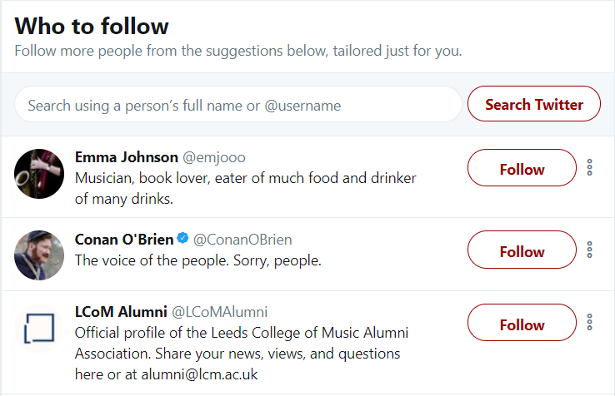
PROBLEM IDENTIFIED

Slide 4







OBJECTIVE
Build a smart recommendation system
Recommends users based on similar sentiments towards topics of interest
LIKES
DISLIKES
Food
Donald Trump
Wine
SMRT
Travel
Haze

Slide 5
DATA
twitter (accessed via api)
location: singapore
~100,000 tweets
expected number of tweets: ~6,000 per day
tokenising
keep words only
stop word removal
stemming
hashtags
user handles
emojis
punctuation

Slide 6

METHODOLOGY
DATA
PROCESSING
RECOMMENDATION
APPLICATION
DATA COLLECTION
TOPIC MODELING
BIPARTITE GRAPH
GRAPH REPRESENTATION
DATA PREPARATION
SENTIMENT ANALYSIS
UNIPARTITE PROJECTION
USER INTERFACE
MAP USERS TO TOPICS
K-MEANS CLUSTERING
WEIGHTED EDGES (SENTIMENT* FREQUENCY)
EVALUATION OF CLUSTERS

Slide 7
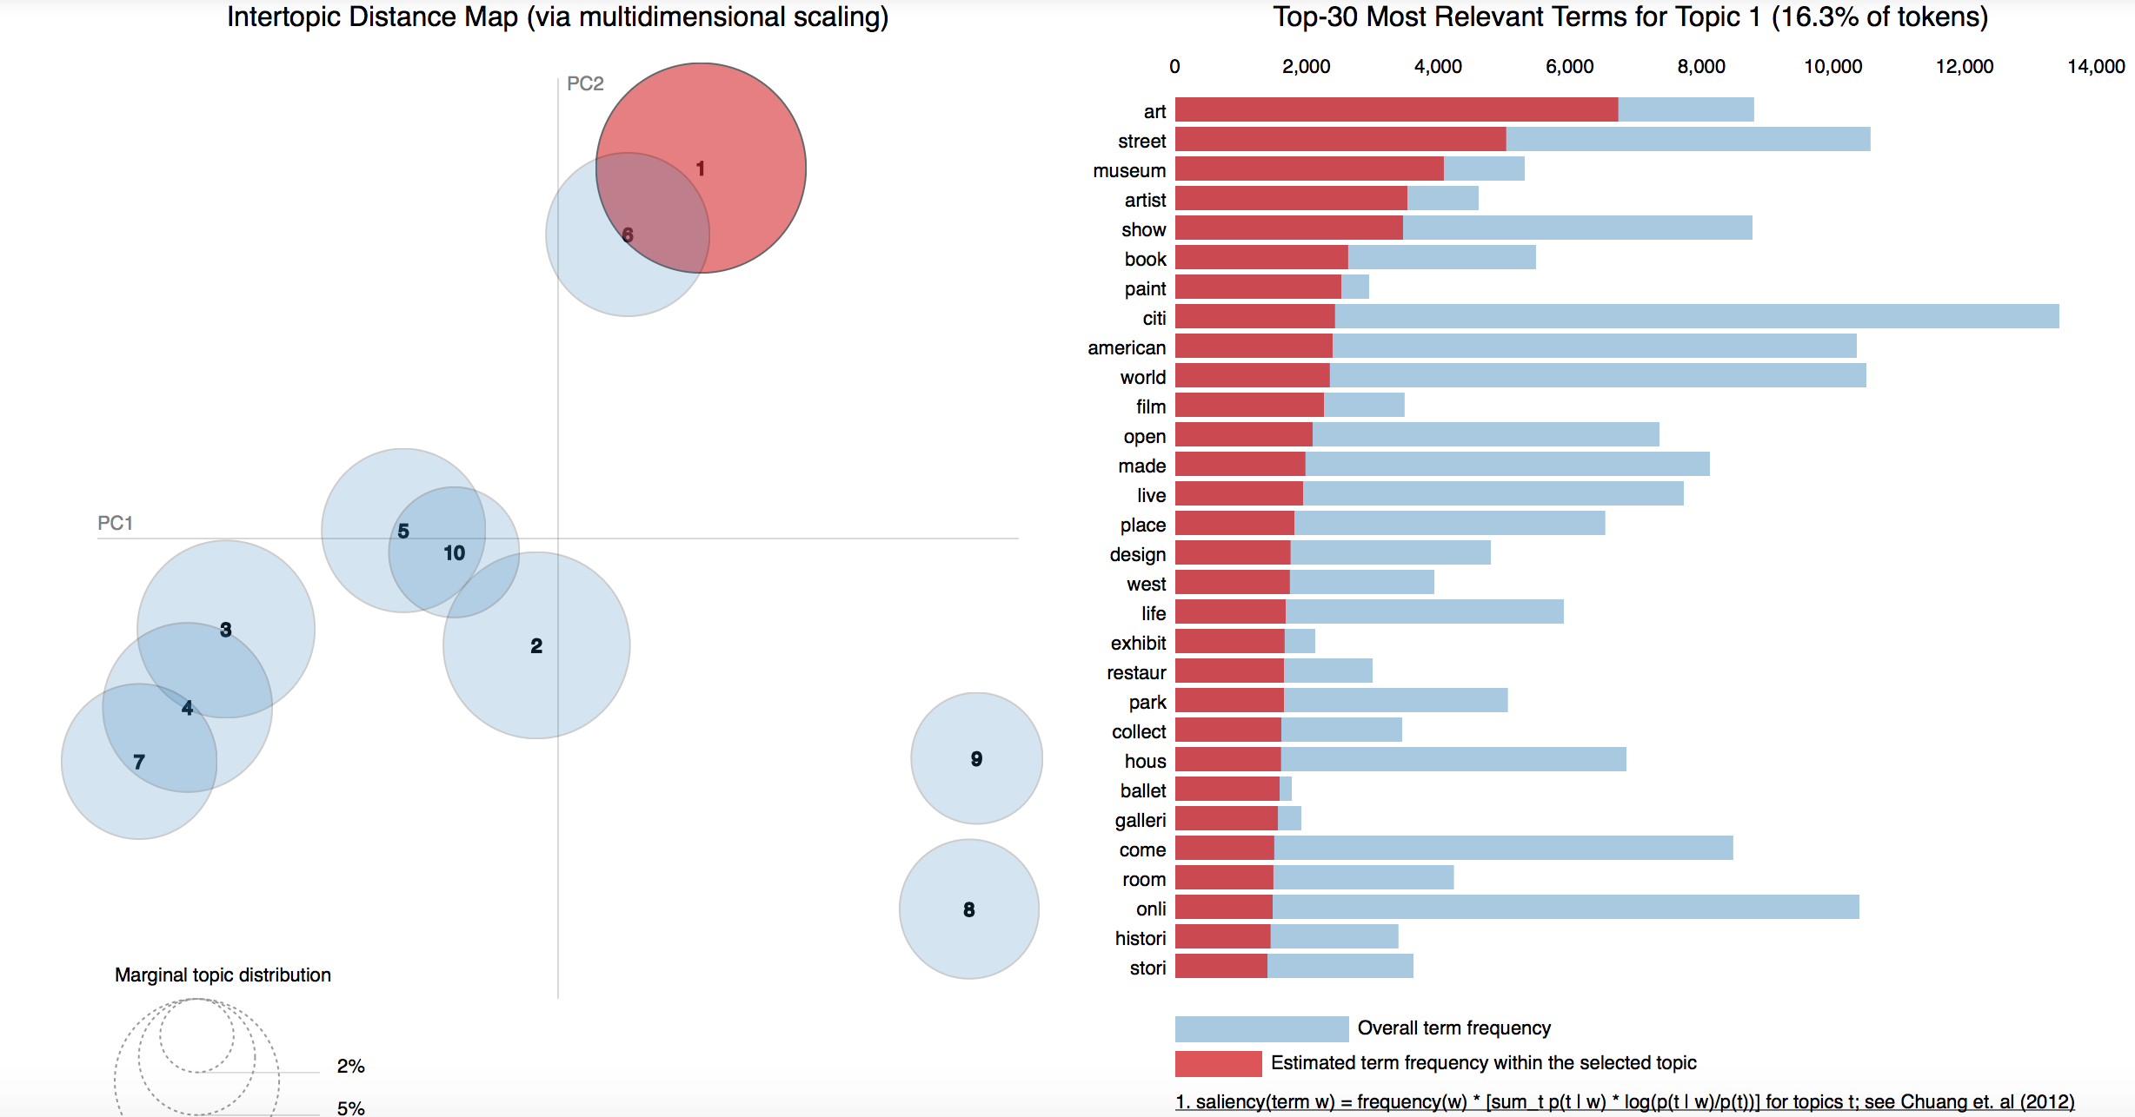
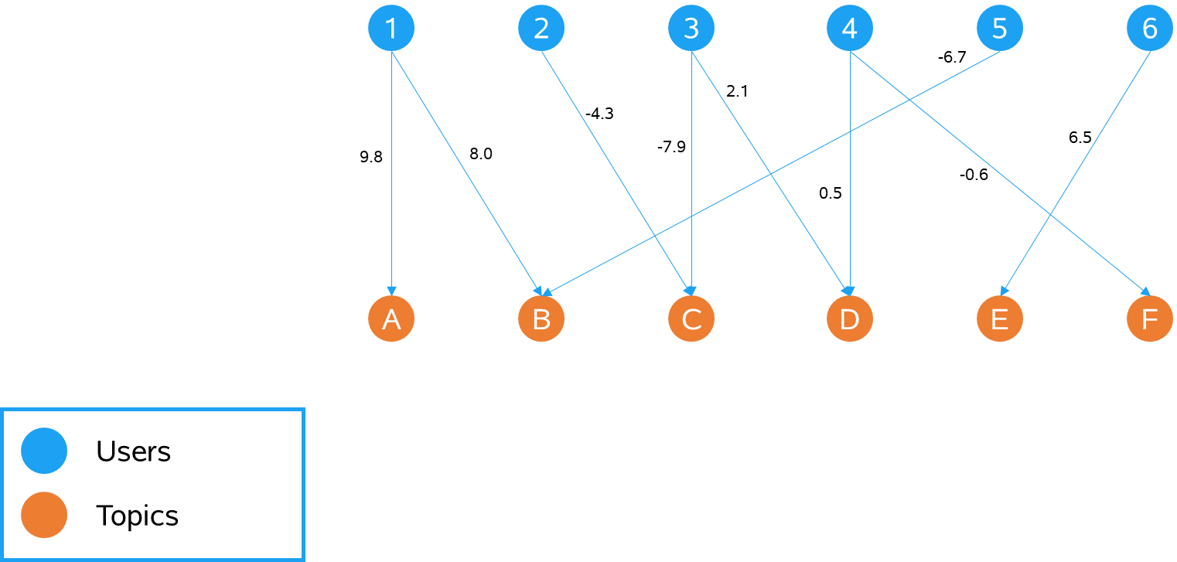
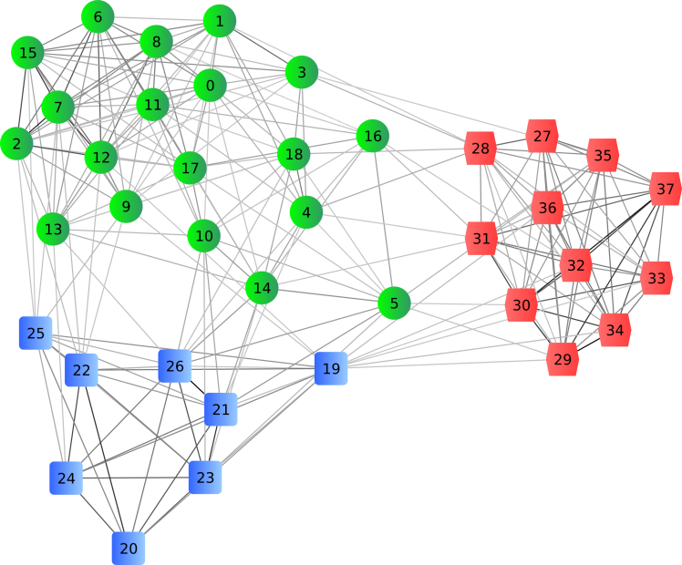
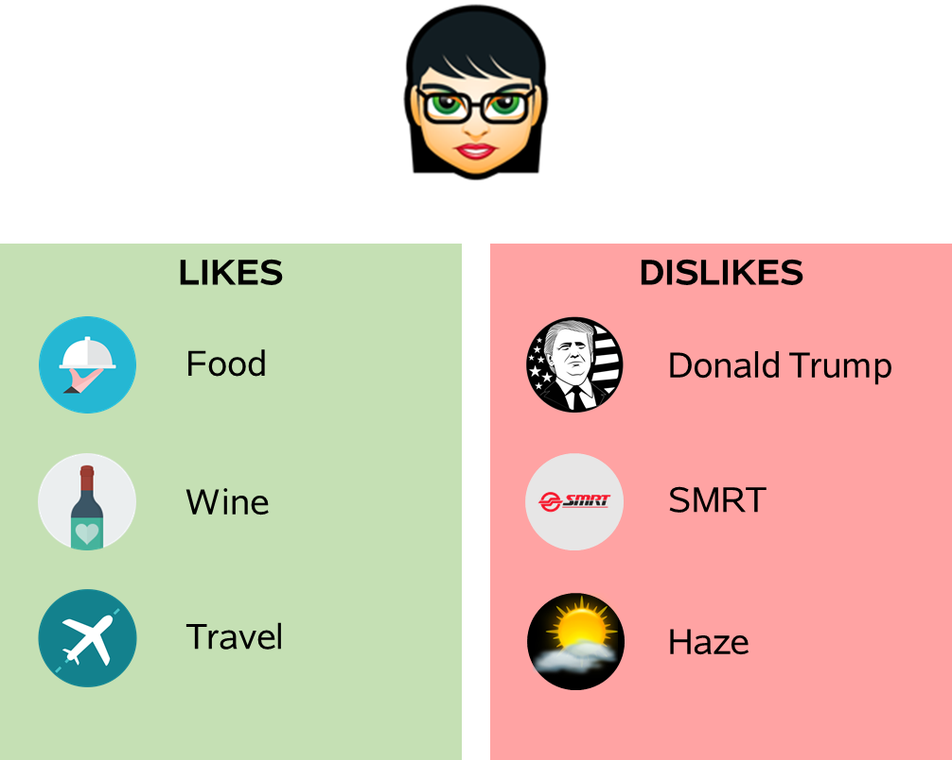
EXPECTED OUTCOME
TOPIC MODELLING
EXPECTED GRAPH OUTPUT
CLUSTERS
USER INTERFACE

Slide 8

EXPECTED CHALLENGES
Multi-lingual text tweets
Hashtags
Identifying clear and concise topics
Real time recommendations based on dynamic input

Slide 9
THANK YOU

